Slide 1


Pooling Body Parts on Feature Maps for Misalignment Robust Person Re-Identiﬁcation
Yuting Liu, Qijun Zhao, Zhihong Wu
College of Computer Science, Sichuan University, Chengdu, China
ISBA 2018 January 12, 2018

Slide 2

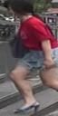
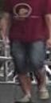
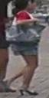
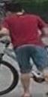

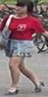
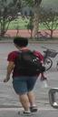

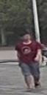
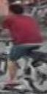



Person Re-identification
Camera Input
Input
Query

Slide 3
Person Re-identification
Camera Input
Input
RankList
Query
Retrieve
. . .

Slide 4
Classical Method
Gallery
Feature Matching
Query
( Euclidean,
KISSME,
XQDA,…)
Feature Extraction
Feature Extraction
(HSV, SILTP, … Deep Features)
(HSV, SILTP,… Deep Features)

Slide 5

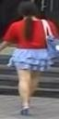
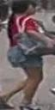
Misalignment
Feature Learning
Feature Matching

Slide 6
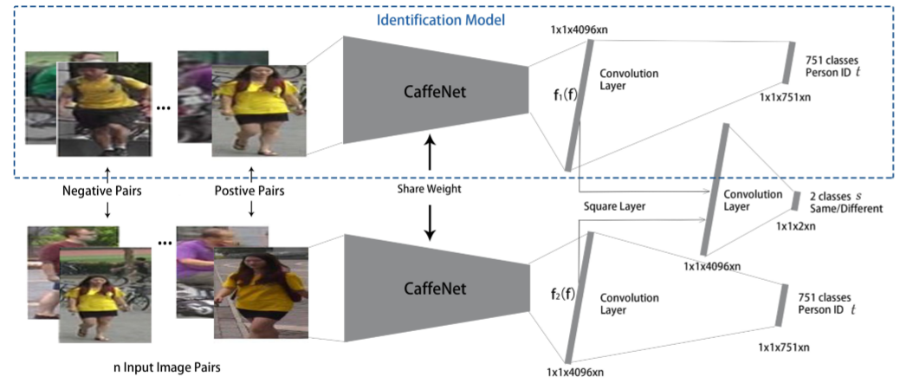
Existing DL Works
Z. Zheng, L. Zheng, Y. Yang. A Discriminatively Learned CNN Embedding for Person Reidentification. ACM Transactions on Multimedia Computing, Communications, and Applications, 2016.

Slide 7
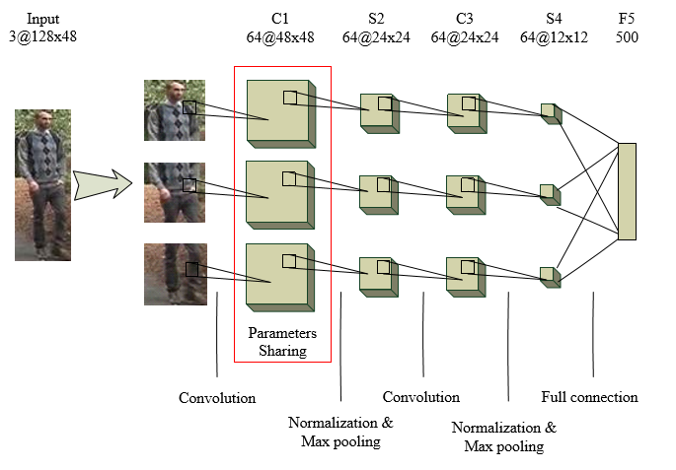
Existing DL Works
D. Yi, Z. Lei, S. Liao, S. Z. Li. Deep Metric Learning for Person Re-identification. In ICPR, 2014.

Slide 8
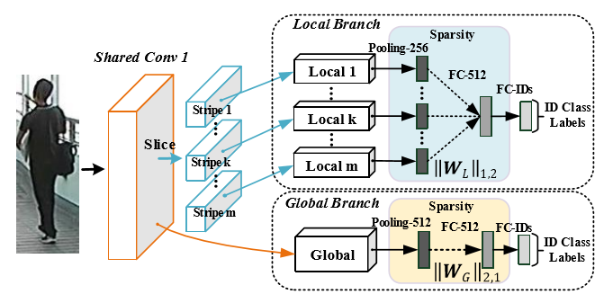
Existing DL Works
W. Li,X. Zhu,S. Gong. Person Re-Identiﬁcation by Deep Joint Learning of Multi-Loss Classiﬁcation. In IJCAI, 2017

Slide 9
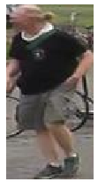
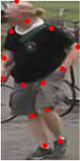
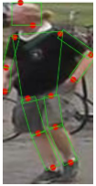
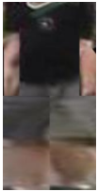
Pose Invariant Embedding(PIE)
original image
estimated pose
body parts
PoseBox
CNN
L. Zheng, Y Huang, H. Lu, and Y. Yang. Pose Invariant Embedding for Deep Person Re-identification. ArXiv
preprint arXiv:1701.07732, 2017.

Slide 10
Pose Invariant Embedding(PIE)
original image
estimated pose
body parts
PoseBox
CNN
Bad PoseBox

Slide 11
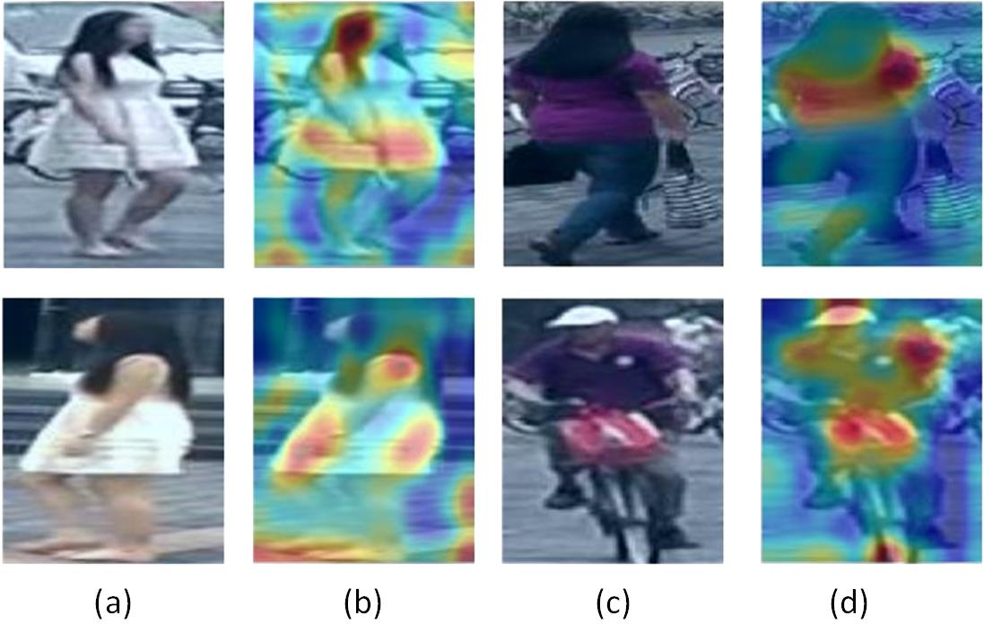
Main Idea
Salient Local Features

Slide 12
Main Idea
Pooling Body Parts on Feature Maps
Image
Feature Map
Max-Pool
Image Level Affine Transformation
Concat

Slide 13
Body Part Segmentation
10 Body Parts
Left Shoulders
Right Shoulders
Left Elbows
Right Elbows
Left Wrists
Right Wrists
Left Hips
Right Hips
Left Knees
Right Knees
Left Ankles
Right Ankles
By Convolution Pose Mechine (CPM) Method

Slide 14
The Deep Joint Learning Network
The Base Network
Image
FC7

Slide 15
The Deep Joint Learning Network
The DJL
FC7
Image & Body Parts

Slide 16
The Deep Joint Learning Network
The DJL
Multi-Loss
Module
FC7
Image & Body Parts

Slide 17
The Deep Joint Learning Network
The DJL
Multi-Loss
Module
FC7
Image & Body Parts
Concat

Slide 18
The Deep Joint Learning Network
Pooling from Multi-layers
Region Re-weighting

Slide 19
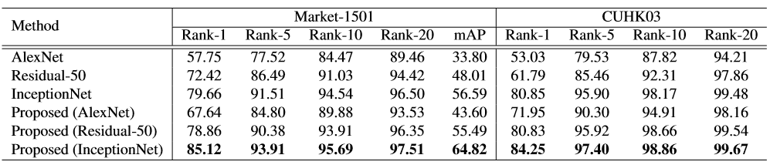
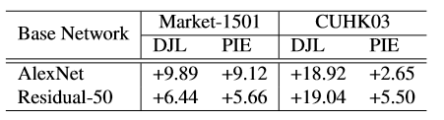
Experimental Results
Comparison with the three base networks
Comparison with PIE

Slide 20
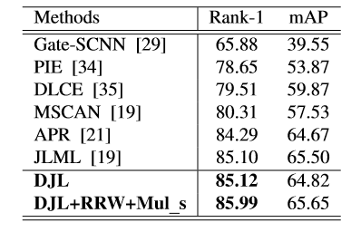
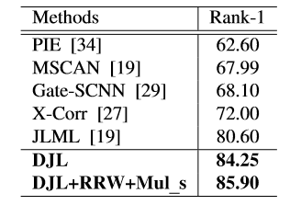
Experimental Results
Comparison with state-of-the-art methods on Market1501 and CUHK03
(a) Comparison with state-of-the-art methods on Market1501. Rank-1 accuracy (%) and mAP (%) are shown.
(b) Comparison with state-of-the-art methods on CUHK03. Rank-1 accuracy (%) is shown.

Slide 21
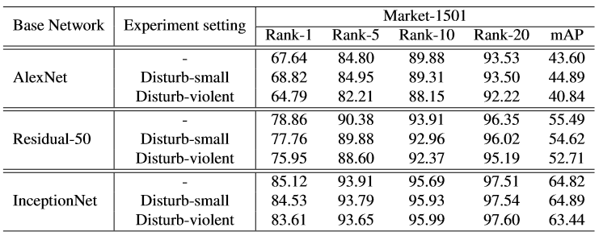
Experimental Results
The impact of body part segmentation error

Slide 22
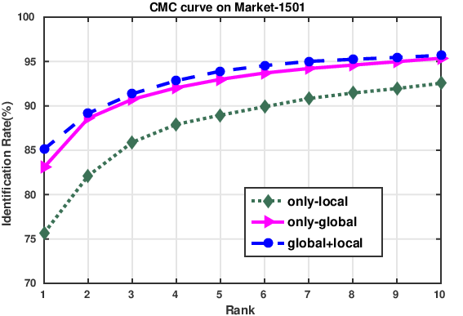
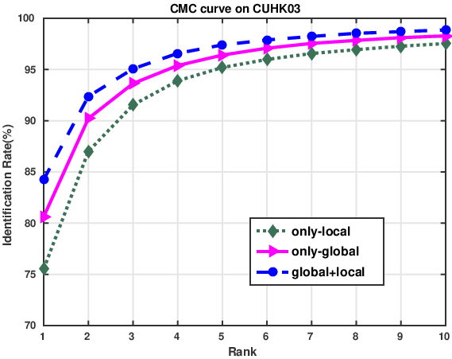
Experimental Results
Complementary effects
(a)
(b)

Slide 23
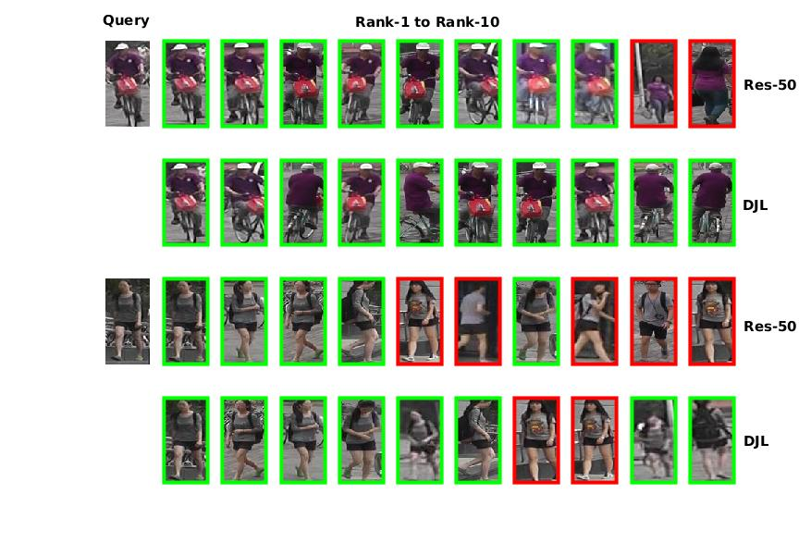
Experimental Results
Retrieval examples

Slide 24
Conclusion
Propose a DJL network to learn better feature representation from both entire image and local body parts.
Do feature level alignment by pooling the features around the body parts to learn misalignment robust local features.
Jointly optimizes the global and aligned local features to further enhance the discriminative capability of learned feature representations.
The simple and efficient DJL pipeline can be easily integrated with other state-of-the-art person re-ID networks

Slide 25
Thank you!
2018 IEEE 4th International Conference on Identity, Security, and Behavior Analysis (ISBA)

